Slide 1
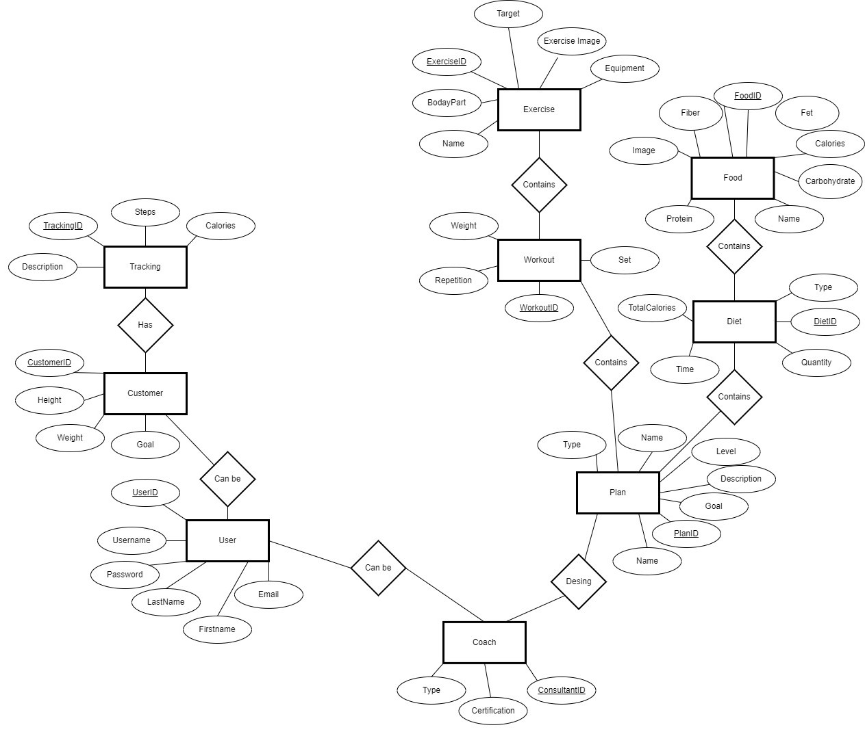
Conceptual ER Diagram I2 Scope Health Application

Slide 2
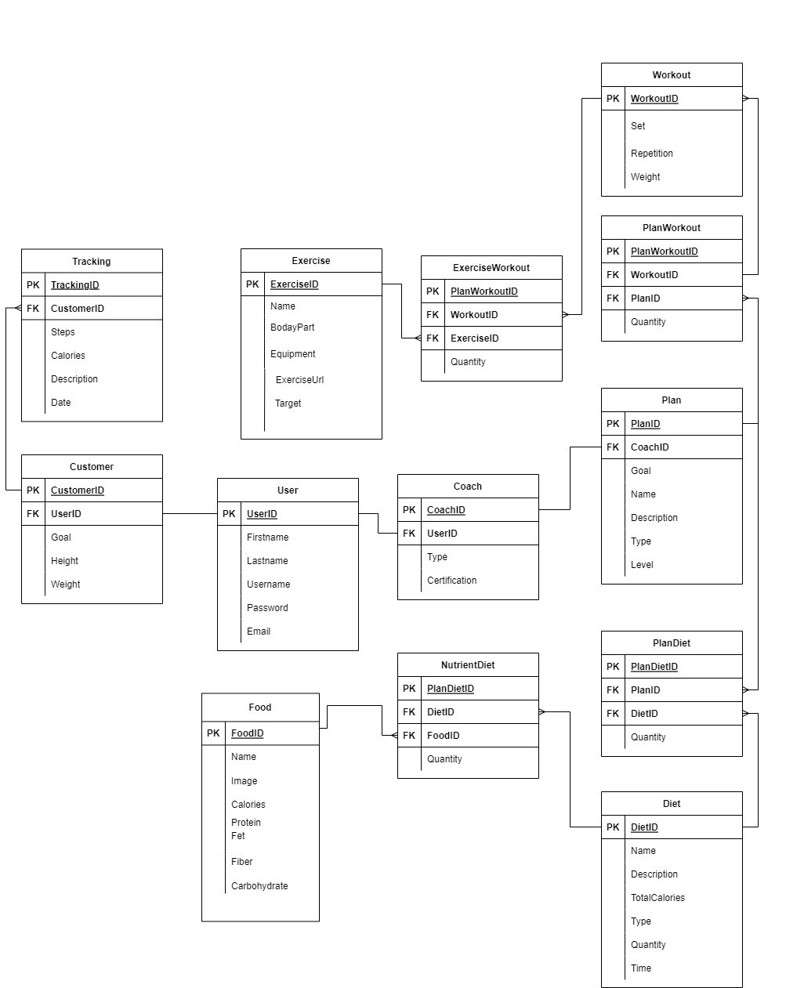
Logical ER Diagram​​– I2 Scope Health Application

Slide 3
Revision Notes
We just remove the name Description and add Exercise Image, Equipment, BodyPart and Target properties on Exercise Table.

